Slide 1

E-Commerce Marketplace Performance Analysis
Data-Driven Insights & Strategic Recommendations

Slide 2
Project Overview & Data Scope
Objective: To analyze 118k+ transactions to identify growth drivers and customer behavior.
Data Sources: 6 Relational datasets (Orders, Customers, Payments, Products, Sellers, and Items).
Tools Used: Python (Pandas/Seaborn), SQL, and Google Colab.

Slide 3
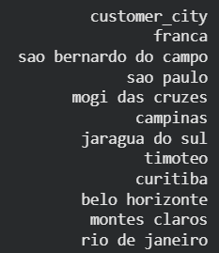
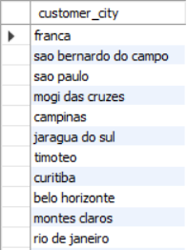
List all unique cities where customers are located.
Python Code | SQL Query
unique_cities_series = customers['customer_city'].unique() unique_cities_df = pd.DataFrame(unique_cities_series, columns=['customer_city']) print(unique_cities_df.to_string(index=False)) | select distinct(customer_city) from customers;
Python Output | SQL Output

Slide 4


Count the number of orders placed in 2017.
Python Code | SQL Query
# Filter orders for the year 2017 orders['order_purchase_timestamp'] = pd.to_datetime(orders['order_purchase_timestamp']) orders_2017 = orders[orders['order_purchase_timestamp'].dt.year == 2017].copy() print(f"Total Orders Placed in 2017: {len(orders_2017)}") | select count(*) as orders_2017 from orders where year(order_purchase_timestamp) = 2017;
Python Output | SQL Output

Slide 5
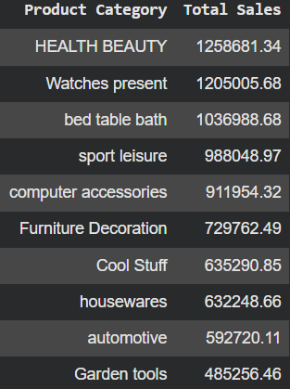
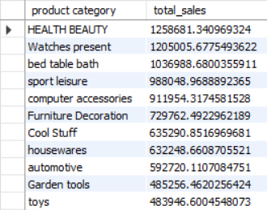
Find the total sales per category.
Python Code | SQL Query
# Merge Order Items and Products sales_data = pd.merge(order_items[['product_id', 'price']], products[['product_id', 'product_category']], on='product_id', how='left') # Aggregation: Sum price per category category_sales = sales_data.groupby('product_category')['price'].sum().reset_index() category_sales.columns = ['Product Category', 'Total Sales'] # Table print("Table: Top 10 Product Categories by Total Sales Value") display(top_10_sales) | select p.`product category`, sum(oi.price) as total_sales from products p join order_items oi on p.product_id=oi.product_id group by p.`product category` order by total_sales desc;
Python Output | SQL Output

Slide 6

Calculate the percentage of orders that were paid in instalments.
Python Code | SQL Query
# Count total unique orders total_orders = payments['order_id'].nunique() # Count unique orders that used installments (more than 1 payment) installment_orders = payments[payments['payment_installments'] > 1]['order_id'].nunique() # Calculate percentage percentage = (installment_orders / total_orders) * 100 print(f"Percentage of orders paid in installments: {percentage:.2f}%") | SELECT (COUNT(DISTINCT CASE WHEN payment_installments > 1 THEN order_id END) * 100.0) / COUNT(DISTINCT order_id) AS installment_percentage FROM payments;
Python Output | SQL Output

Slide 7
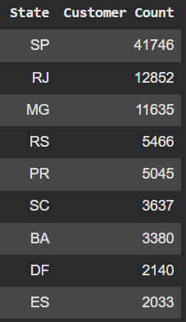
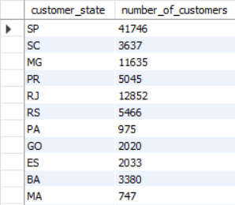
Count the number of customers from each state.
Python Code | SQL Query
# Count customers per state state_counts = customers['customer_state'].value_counts().reset_index() state_counts.columns = ['State', 'Customer Count'] # Table print("Table: Number of Customers by State") display(state_counts) | select customer_state, count(*) as number_of_customers from customers group by customer_state;
Python Output | SQL Output

Slide 8
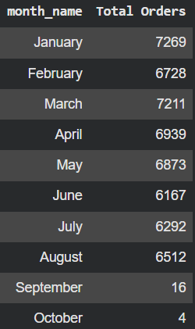
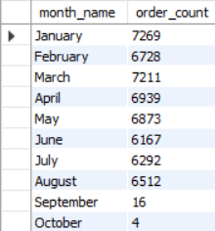
Calculate the number of orders per month in 2018.
Python Code | SQL Query
orders_2018 = orders[orders['order_purchase_timestamp'].dt.year == 2018].copy() orders_2018['month_num'] = orders_2018['order_purchase_timestamp'].dt.month orders_2018['month_name'] = orders_2018['order_purchase_timestamp'].dt.strftime('%B') monthly_orders = orders_2018.groupby(['month_num', 'month_name']).size().reset_index(name='Total Orders') monthly_orders = monthly_orders.sort_values('month_num')[['month_name', 'Total Orders']] display(monthly_orders) | select monthname(order_purchase_timestamp) as month_name, count(*) as order_count from orders where year(order_purchase_timestamp)=2018 group by month_name, month(order_purchase_timestamp) order by month(order_purchase_timestamp);
Python Output | SQL Output

Slide 9
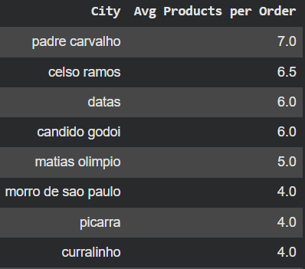
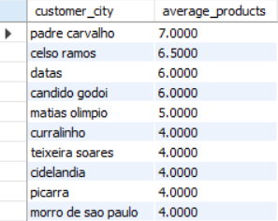
Find the average number of products per order, grouped by customer city.
Python Code | SQL Query
items_per_order = order_items.groupby('order_id').size().reset_index(name='product_count') order_mapping = pd.merge(items_per_order, orders[['order_id', 'customer_id']], on='order_id') order_city_data = pd.merge(order_mapping, customers[['customer_id', 'customer_city']], on='customer_id') city_avg_stats = order_city_data.groupby('customer_city')['product_count'].mean().reset_index() city_avg_stats.columns = ['City', 'Avg Products per Order'] top_10_cities_avg = city_avg_stats.sort_values(by='Avg Products per Order', ascending=False).head(10) display(top_10_cities_avg) | select customer_city, avg(items_per_order) as average_productsfrom (select c.customer_city, o.order_id, count(oi.product_id) as items_per_orderfrom customers cjoin orders o on c.customer_id = o.customer_idjoin order_items oi on o.order_id = oi.order_idgroup by c.customer_city, o.order_id)as order_counts group by customer_city order by average_products desc;
Python Output | SQL Output

Slide 10
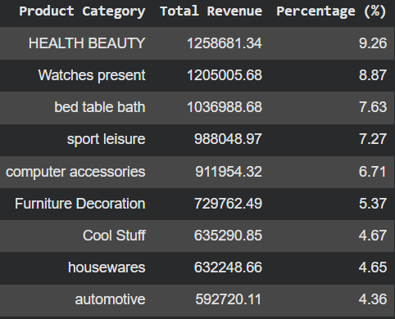
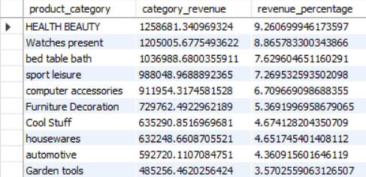
Calculate the percentage of total revenue contributed by each product category.
Python Code | SQL Query
revenue_df = pd.merge(order_items[['product_id', 'price']], products[['product_id', 'product_category’]], on='product_id', how='left') total_marketplace_revenue = revenue_df['price'].sum() category_contribution = revenue_df.groupby('product_category')['price'].sum().reset_index() category_contribution.columns = ['Product Category', 'Total Revenue'] category_contribution['Percentage (%)'] = (category_contribution['Total Revenue'] / total_marketplace_revenue * 100).round(2) display(top_10_contribution) | select p.`product category` as product_category, sum(oi.price) as category_revenue, (sum(price) / (select sum(price) from order_items)) * 100 as revenue_percentagefrom products pjoin order_items oi on p.product_id = oi.product_idgroup by product_categoryorder by revenue_percentage desc;
Python Output | SQL Output

Slide 11
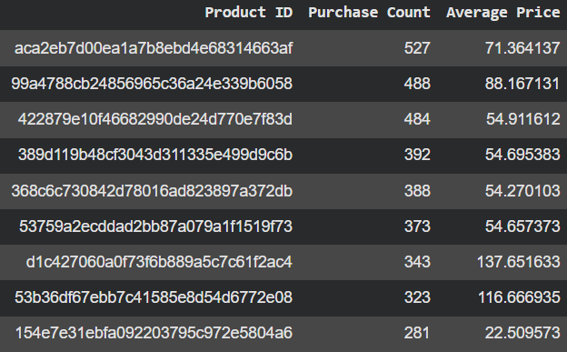
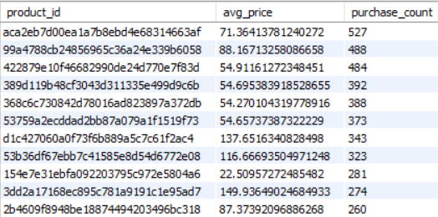
Identify the correlation between product price and the number of times a product has been purchased.
Python Code | SQL Query
product_stats=order_items.groupby('product_id').agg(purchase_count=('order_id', 'count'),avg_price=('price', 'mean')).reset_index() correlation=product_stats['avg_price'].corr(product_stats['purchase_count']) top_products = product_stats.sort_values(by='purchase_count', ascending=False).head(10) top_products.columns = ['Product ID', 'Purchase Count', 'Average Price'] display(top_products) | SELECT product_id, AVG(price) AS avg_price, COUNT(*) AS purchase_count FROM order_items GROUP BY product_id ORDER BY purchase_count DESC;
Python Output | SQL Output

Slide 12
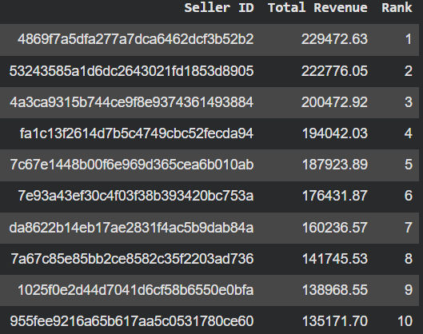
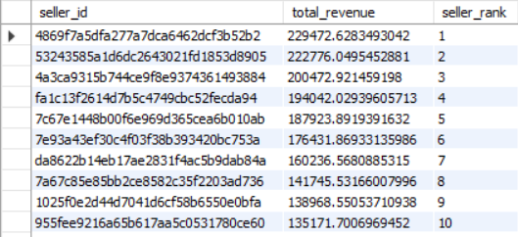
Calculate the total revenue generated by each seller, and rank them by revenue.
Python Code | SQL Query
seller_stats = order_items.groupby('seller_id')['price'].sum().reset_index() seller_stats.columns = ['Seller ID', 'Total Revenue'] seller_stats = seller_stats.sort_values(by='Total Revenue', ascending=False) seller_stats['Rank'] = range(1, len(seller_stats) + 1) top_10_sellers = seller_stats.head(10) display(top_10_sellers) | select seller_id, sum(price) as total_revenue, rank() over (order by sum(price) desc) as seller_rankfrom order_itemsgroup by seller_idorder by seller_rank;
Python Output | SQL Output

Slide 13
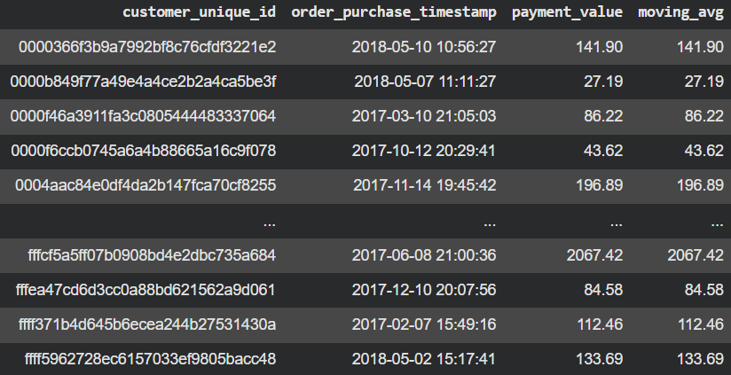
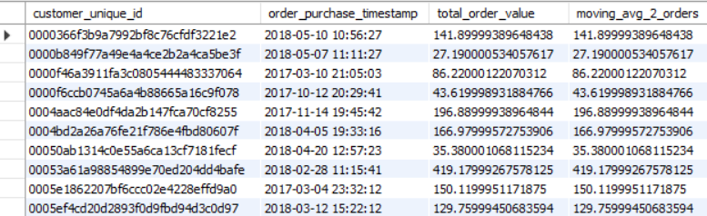
Calculate the moving average of order values for each customer over their order history.
Python Code | SQL Query
order_pay = payments.groupby('order_id')['payment_value'].sum().reset_index() df = pd.merge(orders[['order_id', 'customer_id', 'order_purchase_timestamp']], order_pay, on='order_id') df = pd.merge(df, customers[['customer_id', 'customer_unique_id']], on='customer_id') df = df.sort_values(by=['customer_unique_id', 'order_purchase_timestamp'])df['moving_avg'] = df.groupby('customer_unique_id')['payment_value'].transform(lambda x: x.rolling(window=2, min_periods=1).mean()) display(df[['customer_unique_id', 'order_purchase_timestamp', 'payment_value', 'moving_avg']]) | WITH OrderTotals AS (SELECT c.customer_unique_id, o.order_purchase_timestamp, SUM(p.payment_value) as total_order_value FROM customers c JOIN orders o ON c.customer_id = o.customer_id JOIN payments p ON o.order_id = p.order_id GROUP BY c.customer_unique_id, o.order_id, o.order_purchase_timestamp)SELECT customer_unique_id, order_purchase_timestamp, total_order_value, AVG(total_order_value) OVER ( PARTITION BY customer_unique_id ORDER BY order_purchase_timestamp ROWS BETWEEN 1 PRECEDING AND CURRENT ROW ) AS moving_avg_2_orders FROM OrderTotals;
Python Output | SQL Output

Slide 14
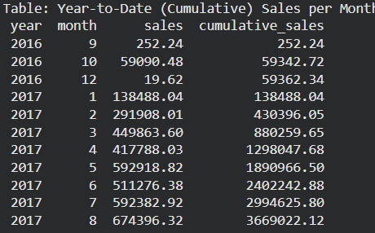
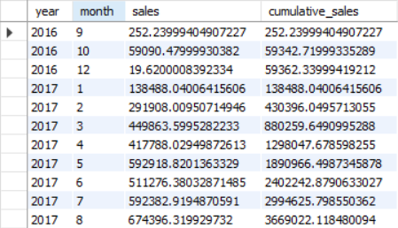
Calculate the cumulative sales per month for each year.
Python Code | SQL Query
order_pay_totals = payments.groupby('order_id')['payment_value'].sum().reset_index() sales_history = pd.merge(orders[['order_id','order_purchase_timestamp','order_status']],order_pay_totals, on='order_id') sales_history['year'] = sales_history['order_purchase_timestamp'].dt.year sales_history['month'] = sales_history['order_purchase_timestamp'].dt.month monthly_totals = sales_history.groupby(['year', 'month'])['payment_value'].sum().reset_index() monthly_totals.columns = ['year', 'month', 'sales'] monthly_totals = monthly_totals.sort_values(['year', 'month']) monthly_totals['cumulative_sales'] = monthly_totals.groupby('year')['payment_value'].cumsum() monthly_totals['month_name'] = monthly_totals['month'].apply(lambda x: calendar.month_name[x]) print("Table: Year-to-Date (Cumulative) Sales per Month") print(monthly_totals[['year', 'month', 'sales', 'cumulative_sales']].to_string(index=False))0).astype(int)) | with monthly_sales as ( select year(order_purchase_timestamp) as year, month(order_purchase_timestamp) as month, sum(p.payment_value) as sales from orders o join payments p on o.order_id = p.order_id group by year, month)select year, month, sales, SUM(sales) over (partition by year order by month) as cumulative_salesfrom monthly_sales;
Python Output | SQL Output

Slide 15
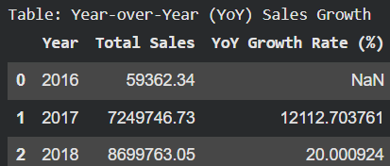

Calculate the year-over-year growth rate of total sales.
Python Code | SQL Query
order_pay_totals = payments.groupby('order_id')['payment_value'].sum().reset_index() orders['order_purchase_timestamp'] = pd.to_datetime(orders['order_purchase_timestamp']) orders['year'] = orders['order_purchase_timestamp'].dt.year annual_df = pd.merge(orders[['order_id', 'year']], order_pay_totals, on='order_id') annual_sales = annual_df.groupby('year')['payment_value'].sum().reset_index() annual_sales.columns = ['Year', 'Total Sales'] annual_sales['YoY Growth Rate (%)'] = annual_sales['Total Sales'].pct_change() * 100 print("Table: Year-over-Year (YoY) Sales Growth") display(annual_sales) | with yearly_sales as ( select year(o.order_purchase_timestamp) as year, sum(p.payment_value) as total_revenue from orders o join payments p on o.order_id = p.order_id group by year)select year, total_revenue, lag(total_revenue) over (order by year) as prev_year_revenue, ((total_revenue - lag(total_revenue) over (order by year)) / lag(total_revenue) over (order by year)) * 100 as yoy_growth_percentagefrom yearly_sales;
Python Output | SQL Output

Slide 16


Calculate the retention rate of customers, defined as the percentage of customers who make another purchase within 6 months of their first purchase.
Python Code | SQL Query
customer_id mapping if needed) df = orders.merge(customers, on='customer_id', how='left') df = df.sort_values(['customer_id', 'order_purchase_timestamp']) first_purchase = df.groupby('customer_id')['order_purchase_timestamp'].min().reset_index() first_purchase.rename(columns={'order_purchase_timestamp': 'first_purchase_date'}, inplace=True) df = df.merge(first_purchase, on='customer_id', how='left') df['within_6_months'] = ((df['order_purchase_timestamp’] > df['first_purchase_date']) & (df['order_purchase_timestamp']<=df['first_purchase_date'] + pd.DateOffset(months=6))) retained_customers = df.groupby('customer_id')['within_6_months'].any().reset_index() retention_rate = retained_customers['within_6_months'].mean() print(f"6-Month Retention Rate: {retention_rate:.2%}") | WITH first_purchase AS ( SELECT customer_id, MIN(order_purchase_timestamp) AS first_purchase_date FROM orders GROUP BY customer_id),repeat_purchase AS ( SELECT o.customer_id, 1 AS is_retained FROM orders o JOIN first_purchase f ON o.customer_id = f.customer_id WHERE o.order_purchase_timestamp > f.first_purchase_date AND o.order_purchase_timestamp <= DATE_ADD(f.first_purchase_date, INTERVAL 6 MONTH) GROUP BY o.customer_id)SELECT ROUND(COUNT(DISTINCT r.customer_id) / COUNT(DISTINCT f.customer_id), 4) AS retention_rateFROM first_purchase f LEFT JOIN repeat_purchase r ON f.customer_id = r.customer_id;
Python Output | SQL Output

Slide 17
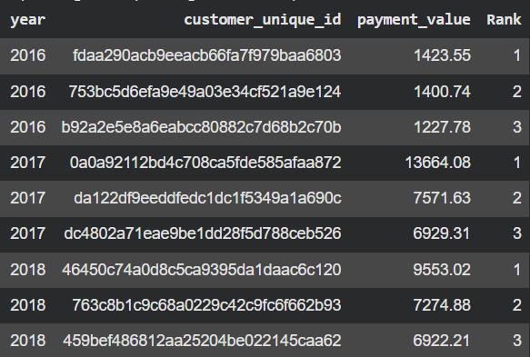
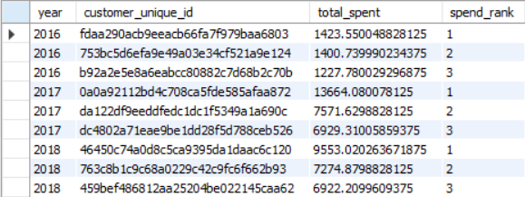
Identify the top 3 customers who spent the most money in each year.
Python Code | SQL Query
order_pay_totals = payments.groupby('order_id')['payment_value'].sum().reset_index() orders['year'] = orders['order_purchase_timestamp'].dt.year df = pd.merge(orders[['order_id', 'year', 'customer_id']], order_pay_totals, on='order_id') df = pd.merge(df, customers[['customer_id', 'customer_unique_id']], on='customer_id') customer_yearly_spending = df.groupby(['year', 'customer_unique_id'])['payment_value'].sum().reset_index() top_3_per_year = customer_yearly_spending.sort_values(['year', 'payment_value'], ascending=[True, False]).groupby('year').head(3) top_3_per_year['Rank'] = top_3_per_year.groupby('year')['payment_value'].rank(ascending=False, method='first').astype(int) display(top_3_per_year) | WITH customer_spending AS ( SELECT year(o.order_purchase_timestamp) as year, c.customer_unique_id, sum(p.payment_value) as total_spent from customers c join orders o on c.customer_id = o.customer_id join payments p on o.order_id = p.order_id group by year, c.customer_unique_id), ranked_customers as ( select year, customer_unique_id, total_spent, dense_rank() over (partition by year order by total_spent desc) as spend_rank from customer_spending)select * from ranked_customers where spend_rank <= 3;
Python Output | SQL Output

Slide 18
Thank You
LinkedIn: https://www.linkedin.com/in/ruchir-a-308240128/
GitHub: https://github.com/ruchira559

